Slide 1
S e c o n d a r y S L P
the one where we teach older kids to talk back the one where we teach kids to talk back

Slide 2
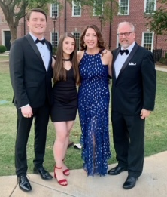
Mary Anne Smith, M.S., CCC-SLP
Texas A&M University ~ Interdisciplinary Studies, B.S., 1996
Middle School Teacher ~ Cypress Fairbanks ISD 1996-97
Ms. Smith’s Tutoring ~1997-2009
Texas Woman’s University, M.S., Communication Sciences Disorders, 2013
Katy ISD 2013 - 2017 ~ SLP
Katy ISD 2017 - 2021 ~ SLP Liaison
Katy ISD 2021 - Present ~Lead SLP
Notes:
The counterargument should be the most common argument against the topic. The goal for this slide is to address the counterargument in such a way as to actually strengthen the original topic. Be sure to address each piece of evidence against the topic. As you address each piece of evidence elaborate on the text found on the slide. Remember to transition to the final slide, the action step.

Slide 3
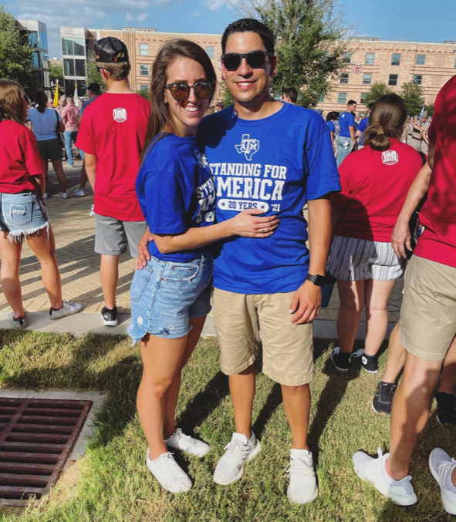
Mandy White, M.S., CCC-SLP
Texas A&M University ~ Communications - 2014
University of Texas at Dallas, M.S., Communication Sciences Disorders, 2016
Katy ISD 2016 - 2021 ~ SLP
Notes:
The counterargument should be the most common argument against the topic. The goal for this slide is to address the counterargument in such a way as to actually strengthen the original topic. Be sure to address each piece of evidence against the topic. As you address each piece of evidence elaborate on the text found on the slide. Remember to transition to the final slide, the action step.

Slide 4
Overview
Settings: medical vs school
SLP – a day in the life
Schedule
ARD & REED meetings
Assessments
Therapy
Notes:
The counterargument should be the most common argument against the topic. The goal for this slide is to address the counterargument in such a way as to actually strengthen the original topic. Be sure to address each piece of evidence against the topic. As you address each piece of evidence elaborate on the text found on the slide. Remember to transition to the final slide, the action step.

Slide 5
Medical Settings vs School Setting: Medical
Home health
Clinics
SNF (skilled nursing facility)– LTAC (long term acute care)
Hospital
inpatient/outpatient/specialization
Pay based on attendance
Holidays
Call/weekends
Notes:
The counterargument should be the most common argument against the topic. The goal for this slide is to address the counterargument in such a way as to actually strengthen the original topic. Be sure to address each piece of evidence against the topic. As you address each piece of evidence elaborate on the text found on the slide. Remember to transition to the final slide, the action step.

Slide 6
Medical Setting vs School Setting: School
Elementary: Pre-K– 5th
Secondary: Junior High/Middle School ~ 6th-8th
Secondary: High School ~ 9th-12th
Salary/Teacher retirement system (TRS)
Time in afternoons/evenings - work in medical setting
Notes:
The counterargument should be the most common argument against the topic. The goal for this slide is to address the counterargument in such a way as to actually strengthen the original topic. Be sure to address each piece of evidence against the topic. As you address each piece of evidence elaborate on the text found on the slide. Remember to transition to the final slide, the action step.

Slide 7
Medical Setting vs School Setting: Eligibility
Medical setting: Diagnosis drives therapy – everyone gets a car!
School setting: Educational need – access to curriculum and least restrictive environment
3 questions determine eligibility
Condition of a disorder
Educational need
Require an SLP
Notes:
The counterargument should be the most common argument against the topic. The goal for this slide is to address the counterargument in such a way as to actually strengthen the original topic. Be sure to address each piece of evidence against the topic. As you address each piece of evidence elaborate on the text found on the slide. Remember to transition to the final slide, the action step.

Slide 8
S L P A day in the life…
This is your circus and these are your monkeys.
Notes:
Be specific and direct in the title. Use the subtitle to give the specific context of the speech.
-The goal should be to capture the audience’s attention which can be done with a quote, a startling statistic, or fact. It is not necessary to include this attention getter on the slide.

Slide 9
Period | Students | Plan/Attendance
1 | 1. Joey T. 2. Monica B. 3. Rachel G. | Language Group: - Story Retell Activity
2 | 1. Meredith G. 2. Cristina Y. 3. Derek S. | Pragmatic Group: - Perspective Taking Activity
3 |  | PLANNING
4 | 1. Brooke D. 2. Lucas S. 3. Nathan S. 4. Peyton S. | Life Skills: - Following Directions Game
5 | 1. David R. 2. Alexis R. 3. Stevie B. 4. Twyla S. | Program Class: - Social Skills Video Modeling
6 | 1. Randall P. 2. Jack P. 3. Kevin P. | ARD
7 | 1. Eric T. 2. Tim R. 3. Lyla G. | Pragmatic/Fluency: - Conversational Maintenance Activity

Slide 10
A day in the life - ARD vs. REED meetings
Present levels of performance
Snap shot of the student
Progress, baseline data, critical needs
Goals
Therapy time
Accommodations
Academic or Behavior concerns
Other
ARD-Admission Review Dismissal
1 time per year or as requested
IEP = Individualized Education Plan
Notes:
Use the background points to post details that are not common knowledge, or that the audience will need to understand the context of the speech.
-Do not read these main points from the PowerPoint, instead elaborate on these points during the speech.

Slide 11
A day in the life - ARD vs. REED meetings
Summarize past evaluations
Consider all areas of eligibility
Communication: articulation, language, fluency, and voice
health, sociological, emotional, academic, etc.,
To test or not to test…
REED-Review Existing Evaluation Data
1 time every 3 years or as requested
FIE = Full Individual Evaluation
Notes:
Use the background points to post details that are not common knowledge, or that the audience will need to understand the context of the speech.
-Do not read these main points from the PowerPoint, instead elaborate on these points during the speech.

Slide 12
A day in the life - Assessments
Standardized vs. Informal
Articulation
Language
Syntax
Semantics
Morphology
Pragmatics
Fluency
Voice
1 time every 3-6 years or as requested
FIE = Full Individual Evaluation
Notes:
Use the background points to post details that are not common knowledge, or that the audience will need to understand the context of the speech.
-Do not read these main points from the PowerPoint, instead elaborate on these points during the speech.

Slide 13
A day in the life - therapy
Articulation
Language
Syntax
Semantics
Morphology
Pragmatics
Fluency
Voice
???
???
Notes:
Use the background points to post details that are not common knowledge, or that the audience will need to understand the context of the speech.
-Do not read these main points from the PowerPoint, instead elaborate on these points during the speech.

Slide 14
to talk back
“Research has found that children and adolescents with ASD benefit from peer-mediated interventions (Bass & Mulick, 2007; Reichow & Volkmar, 2010) and peer mentoring (Morrison, Kamps, Garcia, & Parker, 2001), which incorporates typically developing peers, such as classmates, into therapy to help target behavioral and social strategies (Bellini, Peters, Benner, & Hopf, 2007).”

Slide 15
Goal focus: Language – Pragmatics
Conversation:
Joining, initiating, maintaining, and terminating
Preferred vs non-preferred topics
Expected/Unexpected behaviors =
Friendship making vs. friendship breaking
Problem and two solutions
Perspective taking

Slide 16
Goal Focus: Language
Will provide main idea in complete sentences
When presented with a story, text, or activity, will
provide 3-4 details
Will provide 3-4 part summary in sequential order

Slide 17
Goal Focus: Language
Tier 1, 2, or 3 vocabulary
Synonyms and antonyms
Inferencing
Multiple meaning words
Following Directions - 1 to 4 steps

Slide 18
Goal Focus:
Articulation: will produce vocalic /r/ (air, or, ar)
in all positions of words in phrases
Fluency:
will identify and use a fluency enhancing strategy
will identify negative feelings and use strategies to
make requests or ask questions
Voice: will use front focus technique to reduce laryngeal tension

Slide 19
“Kamhi offers a hypothetical solution for a child in a response-to intervention in school: he assumes a cooperative distribution of language goals among several professionals (e.g., classroom teacher, reading specialist, special educator) and recommends that SLPs concentrate on the teaching of narratives. He points to the flexibility that narratives offer for targeting multiple components and levels of language as well as working in both oral and written modalities.”
Scott, C. M., & Rush University Medical Center. (2012). One Size Does Not Fit All: Improving Clinical Practice in Older Children and Adolescents With Language and Learning Disorders.

Slide 20
Therapy Fun!
Stomp rockets
Baking
Science experiments

Slide 21
GRADUATION DAY!!

Slide 22
Questions and Answers
Settings: medical vs school
SLP – a day in the life
Schedule
ARD & REED meetings
Assessments
Therapy
Notes:
The counterargument should be the most common argument against the topic. The goal for this slide is to address the counterargument in such a way as to actually strengthen the original topic. Be sure to address each piece of evidence against the topic. As you address each piece of evidence elaborate on the text found on the slide. Remember to transition to the final slide, the action step.

